Slide 1
A Practice for SQL using MySQL
Introduction to Database
KAIST

Slide 2
MySQL

Slide 3
MySQL
The most popular Relational Database Management System (RDBMS)
Users can get the results of a SQL statement using MySQL client (e.g. MySQL workbench)
SQL statement
MySQL
client
MySQL server
Result
DB

Slide 4
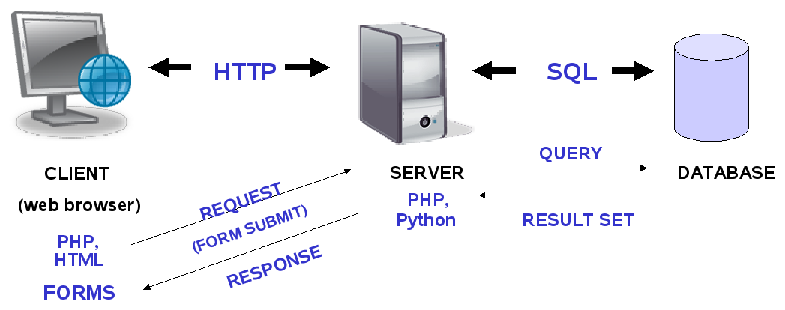
MySQL with Web
Architecture

Slide 5
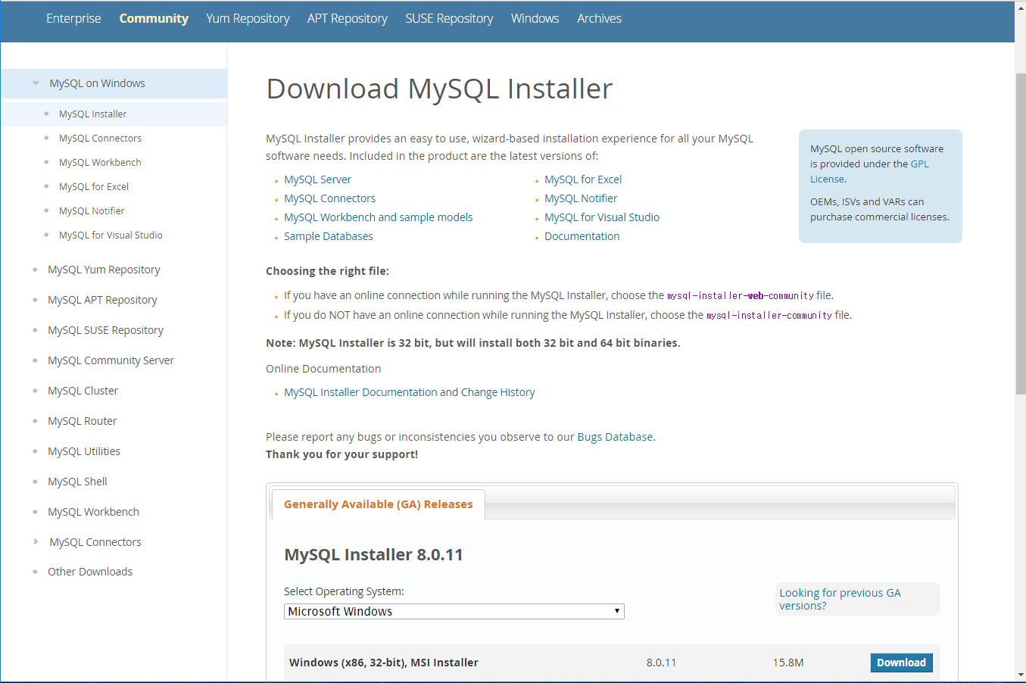
MySQL installation
MySQL installer https://dev.mysql.com/downloads/windows/installer/
Download the installer file corresponding to your OS

Slide 6
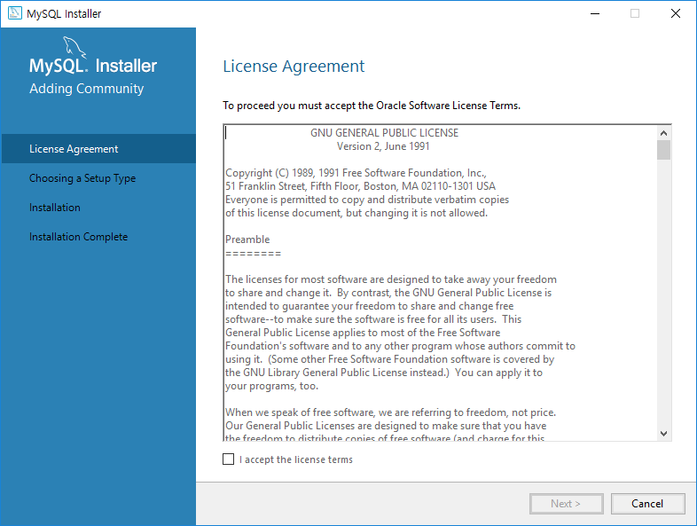
MySQL installation
MySQL installation
mysql-installer-web-community-8.0.11.0.msi (or lastest version)

Slide 7
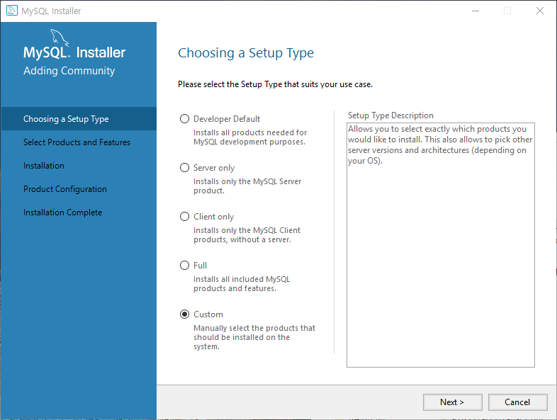
MySQL installation
Choosing a setup type
Developer default
Server only
Client only
Full
Custom

Slide 8
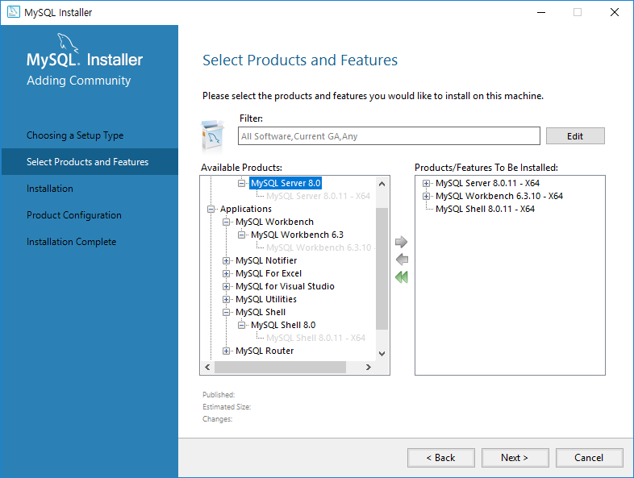
MySQL installation
Choosing a setup type
Install MySQL server, MySQL workbench, and MySQL shell

Slide 9
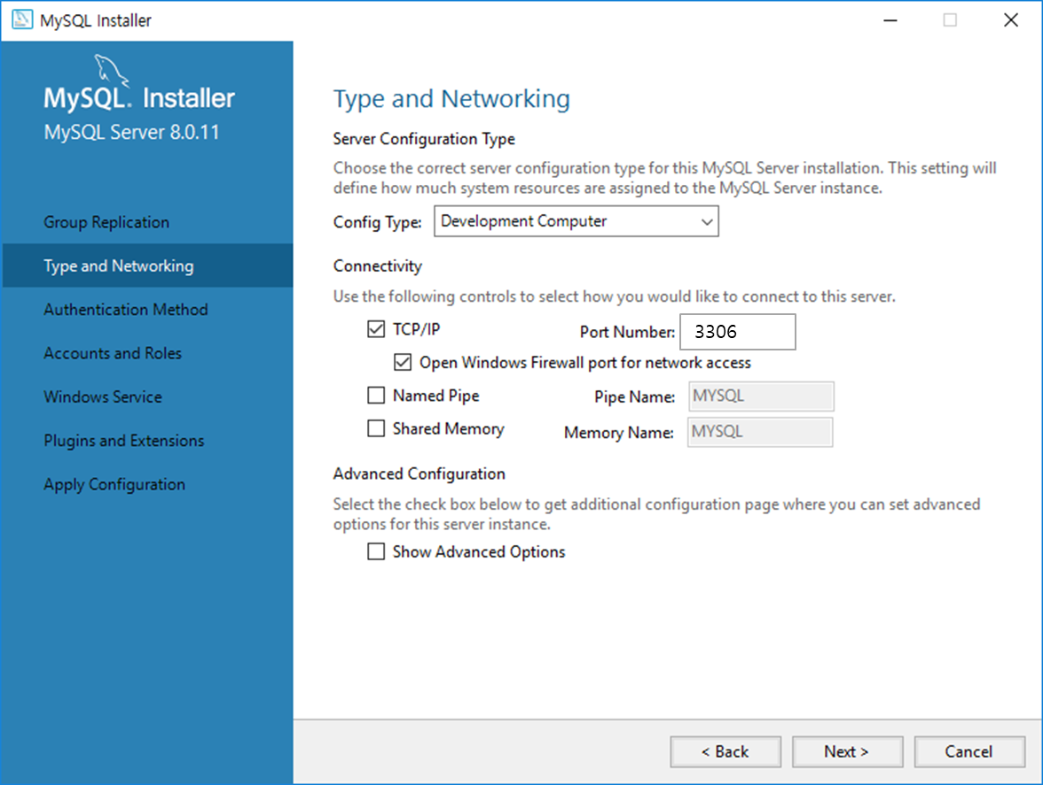
MySQL installation
Server configuration
Configure the type and connectivity of MySQL server
Default port number: 3306

Slide 10
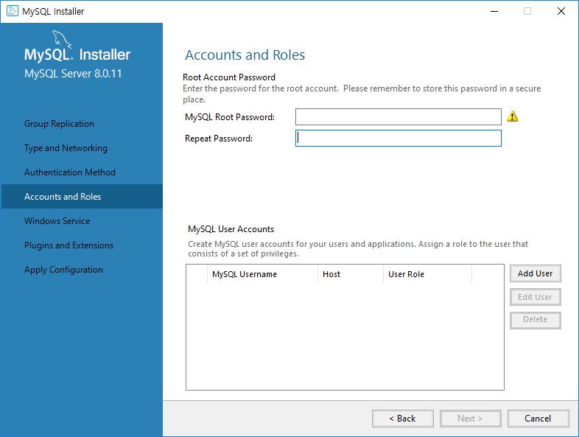
MySQL installation
Server configuration
Setting root and user accounts

Slide 11
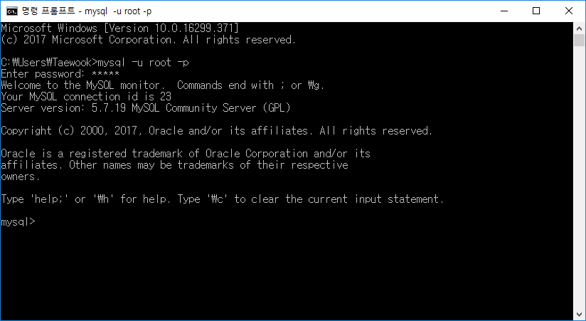
MySQL connection
Using the command line prompt
Type “mysql –u root –p”

Slide 12
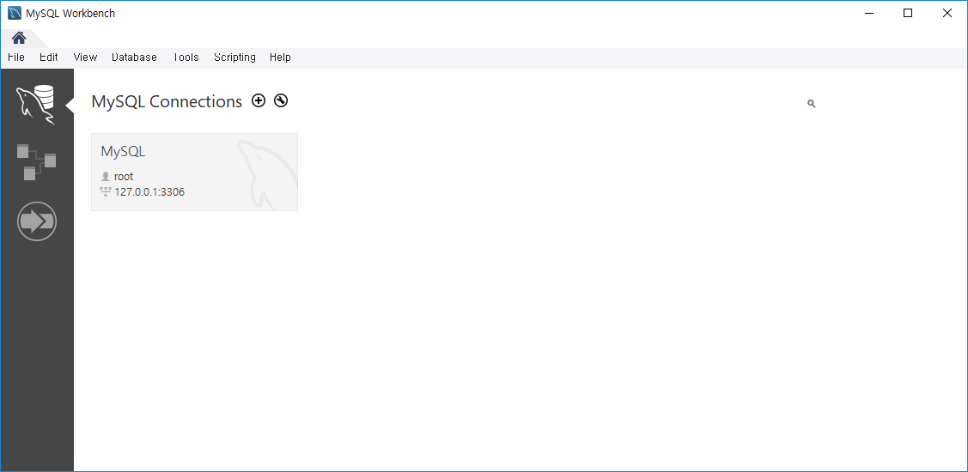
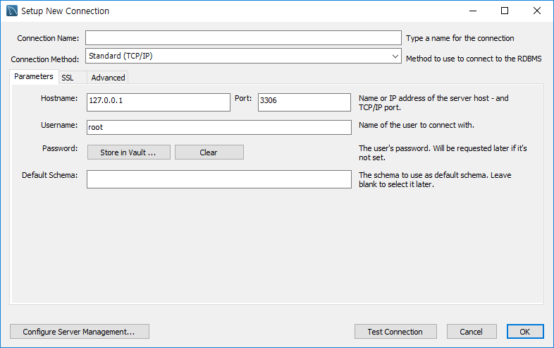
MySQL connection
Using MySQL workbench
Execute the program and connect to the database

Slide 13
MySQL Commands

Slide 14
MySQL Commands
MySQL commands
HELP
Shows a list of all MySQL commands
EXIT, QUIT
Exit mysql
SOURCE
Execute an SQL script file. Takes a file name as an argument
Show databases
Shows all databases
USE
Use a database. Takes database name as an argument
DESCRIBE
Describe a database. Takes database name as an argument
You should type semicolon ‘;’ at the end of the command

Slide 15
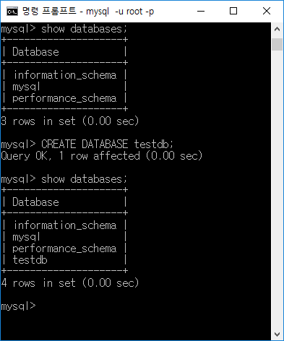
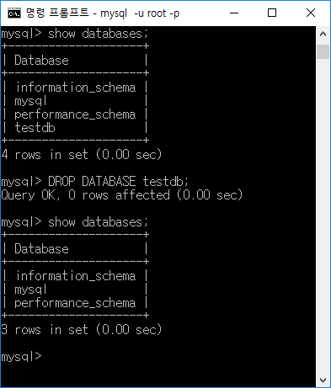
MySQL Commands
MySQL commands
CREATE DATABASE
Create a database. Takes a database name as an argument
DROP DATABASE
Drop a database. Takes a database name as an argument

Slide 16
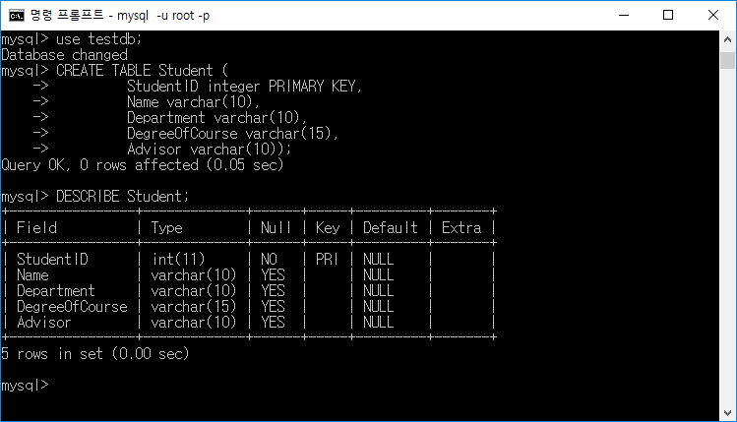
Sample SQLs
Create table
CREATE TABLE Student (
StudentID integer PRIMARY KEY,
Name varchar(10),
Department varchar(10),
DegreeOfCourse varchar(15),
Advisor varchar(10) );
Result
DESCRIBE Student;

Slide 17
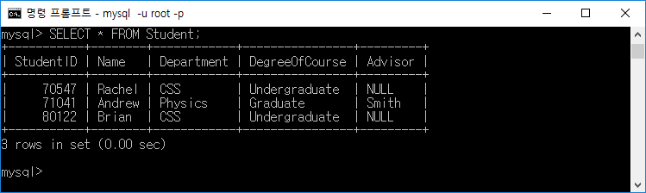
Sample SQLs (cont’d)
Insert tuple
INSERT INTO Student(StudentID, Name, Department, DegreeOfCourse, Advisor) VALUES(70547, 'Rachel', 'CSS', 'Undergraduate', NULL);
INSERT INTO Student(StudentID, Name, Department, DegreeOfCourse, Advisor) VALUES(71041, 'Andrew', 'Physics', 'Graduate','Smith');
INSERT INTO Student(StudentID, Name, Department, DegreeOfCourse) VALUES(80122, 'Brian', 'CSS', 'Undergraduate');
Result
SELECT * FROM Student;

Slide 18
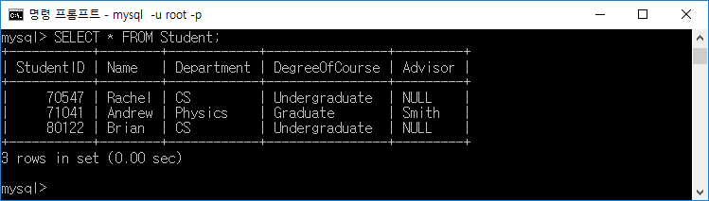
Sample SQLs (cont’d)
Update tuple
UPDATE Student
SET Department = 'CS'
WHERE Department = 'CSS';
Result
SELECT * FROM Student;

Slide 19
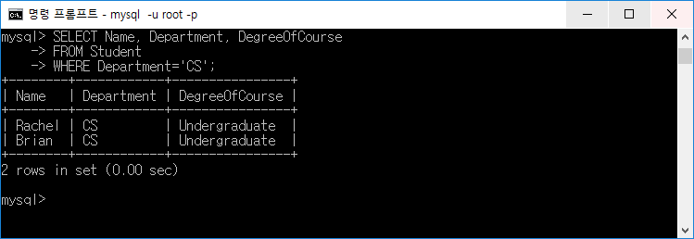
Sample SQLs (cont’d)
Select tuple
SELECT Name, Department, DegreeOfCourse
FROM Student
WHERE Department = 'CS';
Result

Slide 20
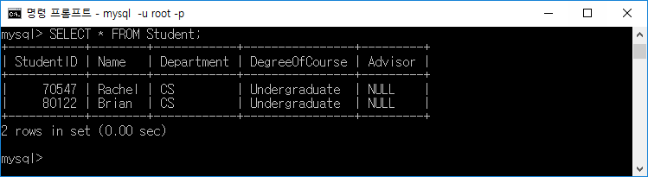
Sample SQLs (cont’d)
Delete tuple
DELETE FROM Student
WHERE DegreeOfCourse='Graduate';
Result
SELECT * FROM Student;

Slide 21
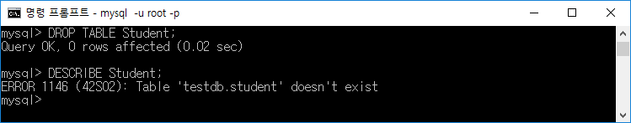
Sample SQLs (cont’d)
Drop table
DROP TABLE Student;
Result
DESC Student;

Slide 22
SQL Practice
Download exampledb.sql in course homepage
http://klms.kaist.ac.kr
Move the exampledb.sql file to the specific folder
Execute exampledb.sql with SOURCE command
SOURCE ‘path-to-file’
Student | StudentID | Name | Department | DegreeOfCourse | Advisor
 | 70547 | Rachel | Computer Science | Undergraduate
 | 71041 | Andrew | Physics | Graduate | Smith
 | …
ScoreRecord | StudentID | CourseID | Score
 | 70547 | CS310 | 3.7
 | 80122 | CS202 | 3.3
 | …
Course | CourseID | Name | Instructor | Credit
 | CS101 | Introduction to Programming | Paul | 3
 | CS202 | Problem Solving | Jane | 3
 | …

Slide 23
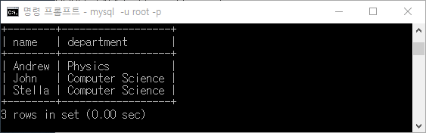
SQL Practice (cont’d)
Q1. Selection / Projection
List the names and departments of the graduate students in the increasing order of their name
Result
Answer
SELECT name, department FROM Student WHERE DegreeOfCourse = ‘Graduate’ ORDER BY name

Slide 24
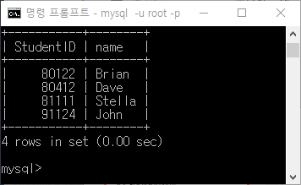
SQL Practice (cont’d)
Q2. Join
List the StudentIDs and the names of the students who scored 4.0 or more at the CS360
Result
Answer
SELECT S.StudentID, S.name FROM Student S, ScoreRecord R WHERE S.StudentID = R.StudentID AND
R.CourseID = ‘CS360’ AND
R.Score >= 4.0

Slide 25
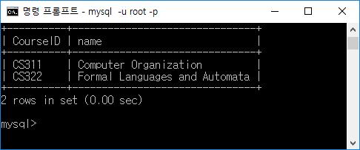
SQL Practice (cont’d)
Q3. Subquery (Use the set operator ‘(NOT) IN’)
List the ids and names of Courses that no student has applied.
Result
Answer
SELECT CourseID, name FROM Course WHERE CourseID NOT IN(SELECT CourseID FROM ScoreRecord)

Slide 26
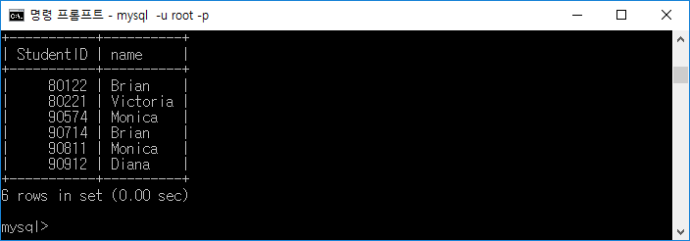
SQL Practice (cont’d)
Q4. Pattern matching
List of the StudentIDs and the names of students whose names contains ‘i’.
Result
Answer
SELECT StudentID, name
FROM Student
WHERE name LIKE ‘%i%'

Slide 27
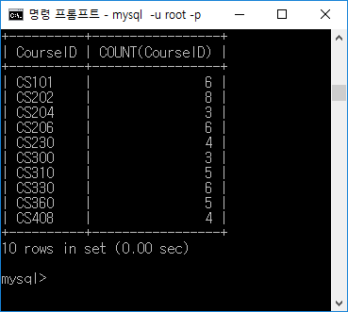
SQL Practice (cont’d)
Q5. Aggregation and Group By
For each Course, count the number of students who applied the course.
show courseID and the number of students
you can omit the courses that no student applied
Result
Answer
SELECT CourseID, COUNT(CourseID)
FROM ScoreRecord
Group By CourseID

Slide 28
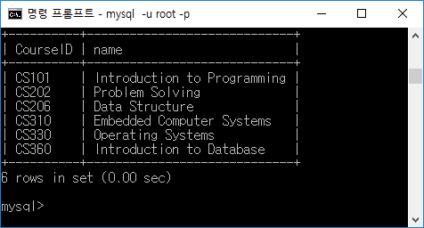
SQL Practice (cont’d)
Q6. Having
List the ids and names of Courses who have more than 4 students.
Result
Answer
SELECT C.CourseID, C.name
FROM Course C, (SELECT CourseID, COUNT(CourseID)
FROM ScoreRecordGroup By CourseID
Having COUNT(CourseID) > 4) CID
WHERE C.CourseID = CID.CourseID;

Slide 29
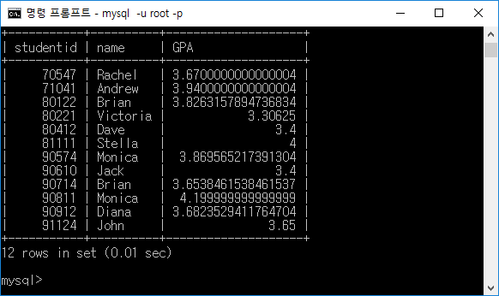
SQL Practice (cont’d)
GPA = sum(score * credit) / sum(credit)
Q7. Aggregation
For each student, list student id, student name, and his/her GPA
Result
Answer
SELECT s.studentid, s.name, SUM(r.score*c.credit)/SUM(c.credit) AS GPA
FROM STUDENT s, SCORERECORD r, COURSE c
WHERE s.studentid = r.studentid AND r.courseid = c.courseid
GROUP BY s.studentid, s.name;

